Slide 1

SURVIVE
FROM CURIOUS MINDS COME HELPING HANDS​

Slide 2
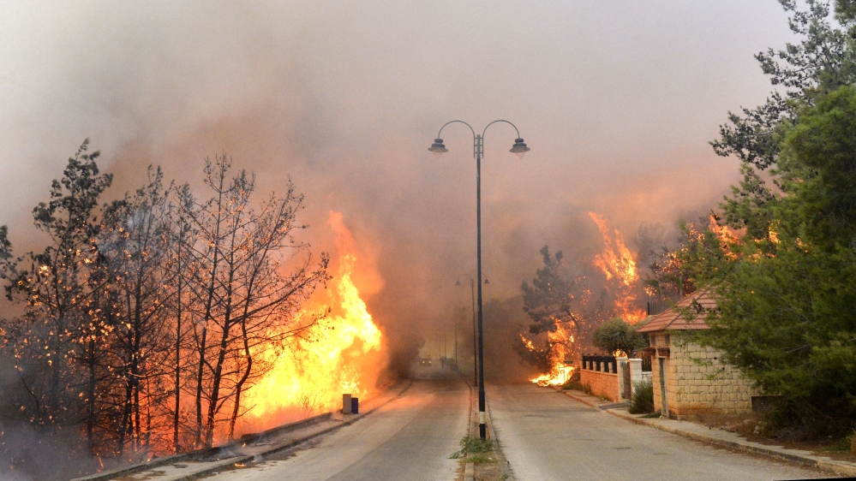
What is happening?

Slide 3
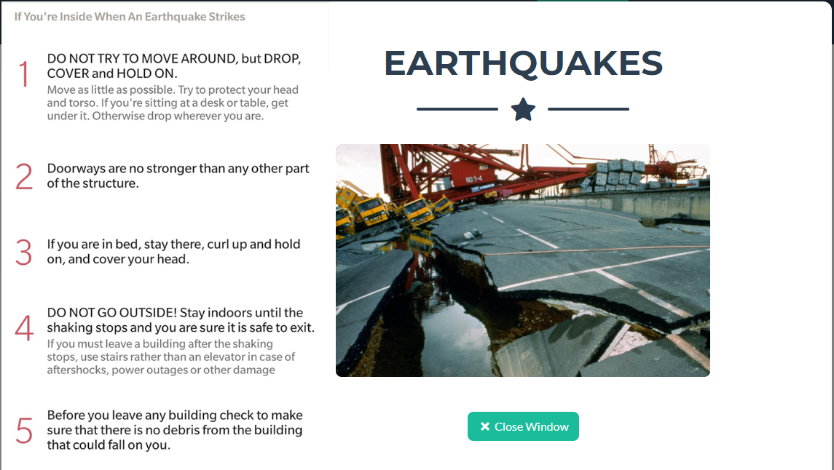
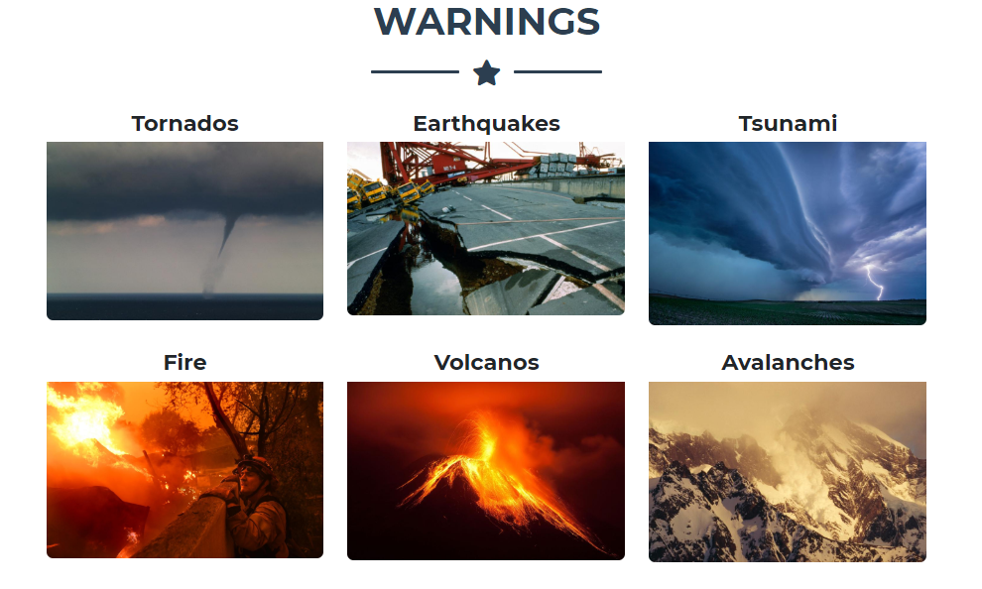
Our solution.
Locate Natural Disasters
Locate all the Phones on the zone
Send notifies - Warnings

Slide 4
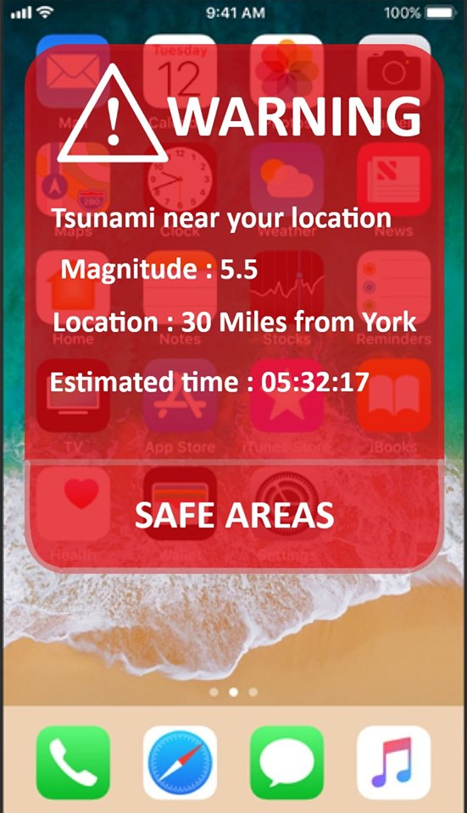
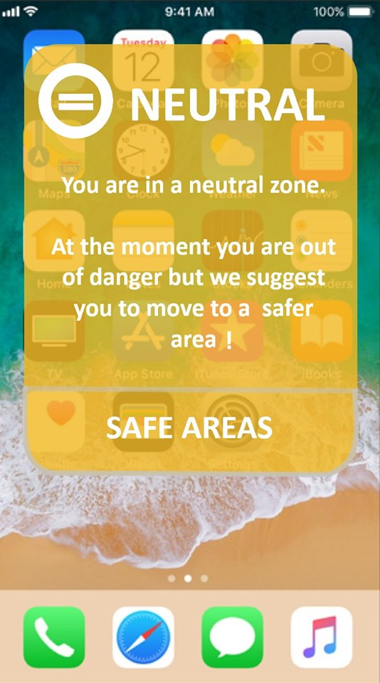
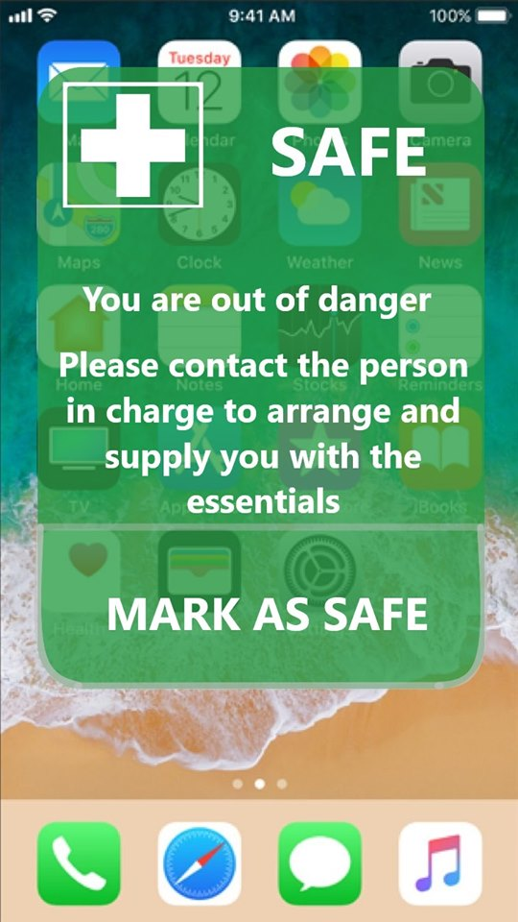
How will I survive?
Step 1 Get the warning
Step 2 Click the button
Step 3 Check the map

Slide 5
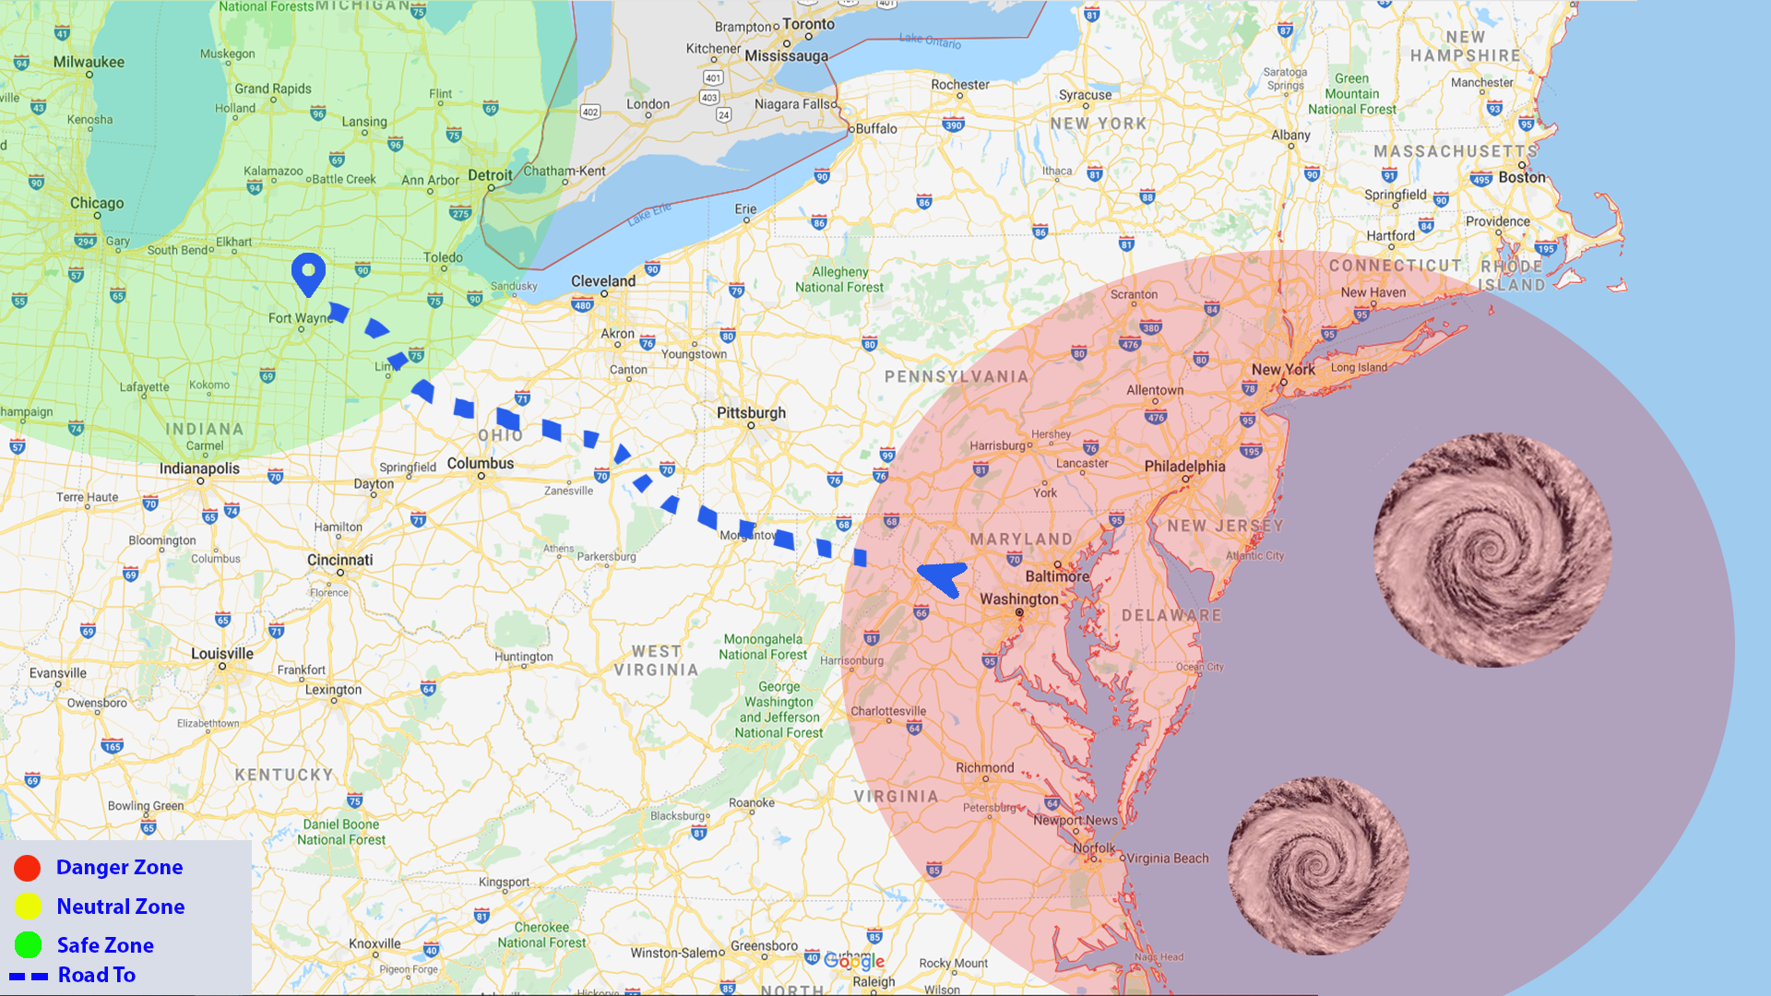

Slide 6
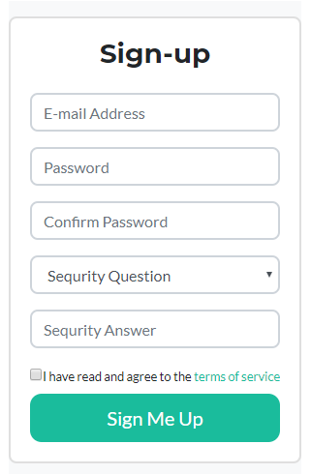
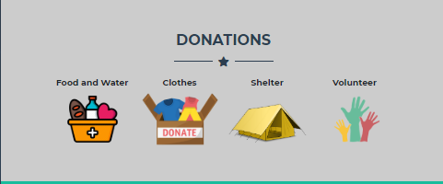
Do you want to help?
Join us
How can you help?
Donate.

Slide 7



THANK YOU!

